Slide 1
BMW SALES DASHBOARD
Insights, trends and business interpretation
Presented by: Hanshika Chaudhary
Course: BBA in Business Analytics in collaboration with IBM
Section: BBABA23
SUBJECT Teacher: Mr. Shubham Pathak

Slide 2
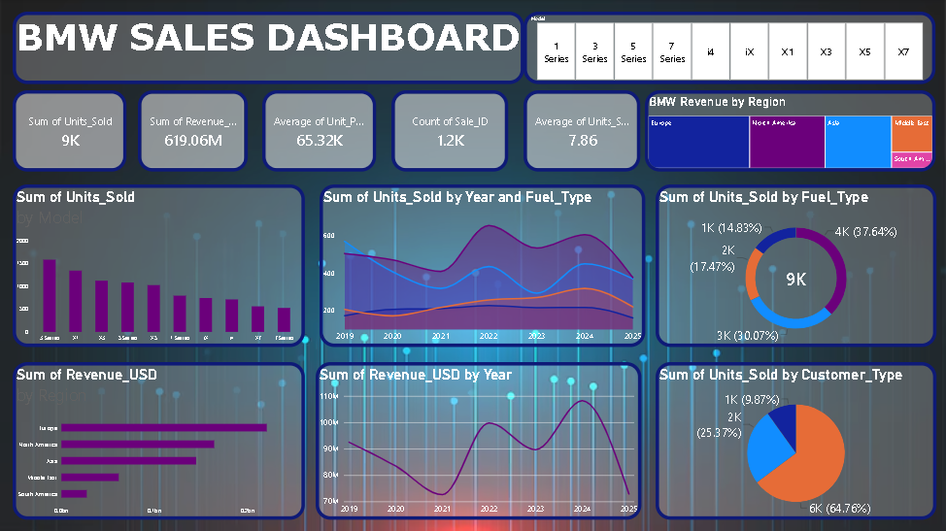
1. Dashboard Overview
A single-page view of sales volume, revenue, product mix and customer segments.

Slide 3


2. KPI Cards — Overall Performance

Slide 4




Slide 5

3. Series / Model Slicer
KEY TAKEAWAY

Slide 6
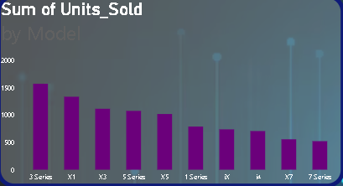
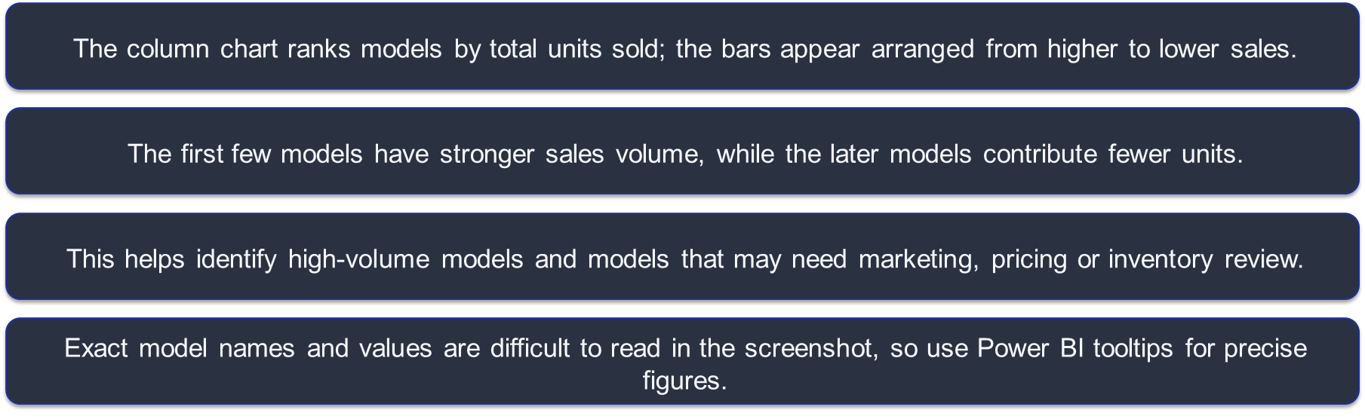
4. Units Sold by Model
KEY TAKEAWAY
Focus inventory and promotion decisions on the best-selling models, while investigating lower-volume models.

Slide 7
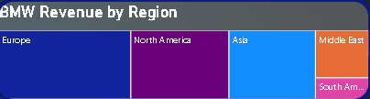
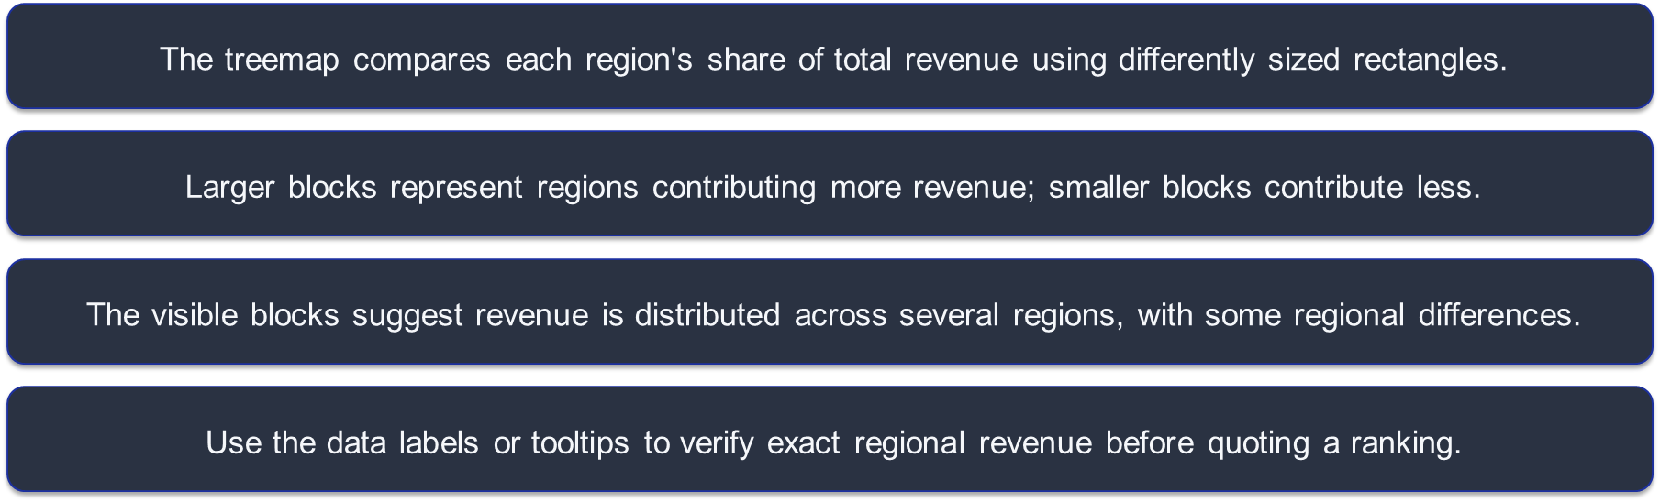
5. Revenue by Region
KEY TAKEAWAY
Compare regional contribution to spot strong markets and opportunities for regional growth.

Slide 8
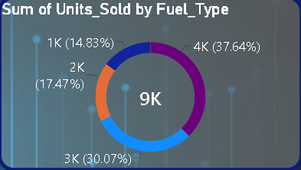
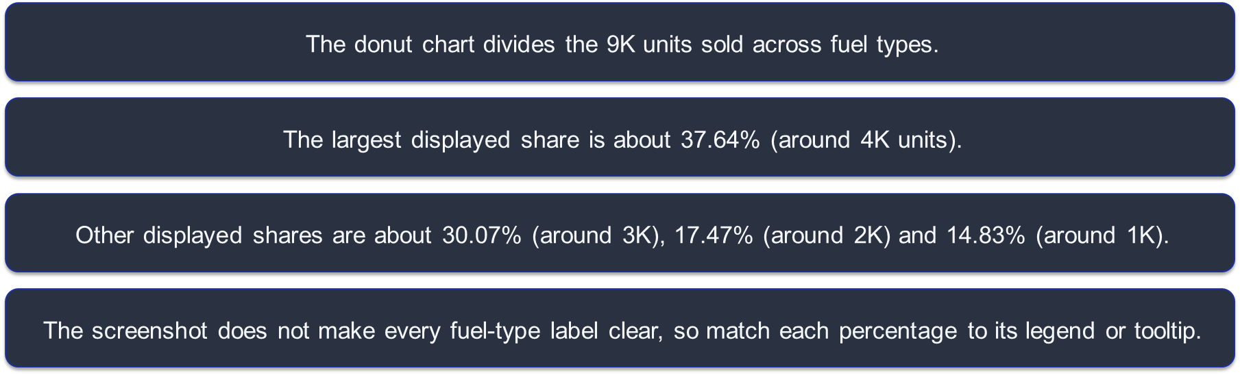
6. Units Sold by Fuel Type
KEY TAKEAWAY
The sales mix is not evenly split; one fuel category contributes the largest share.

Slide 9
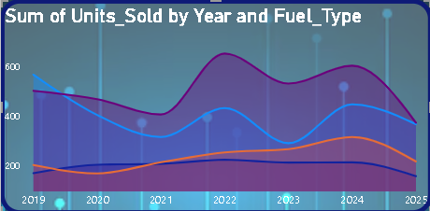
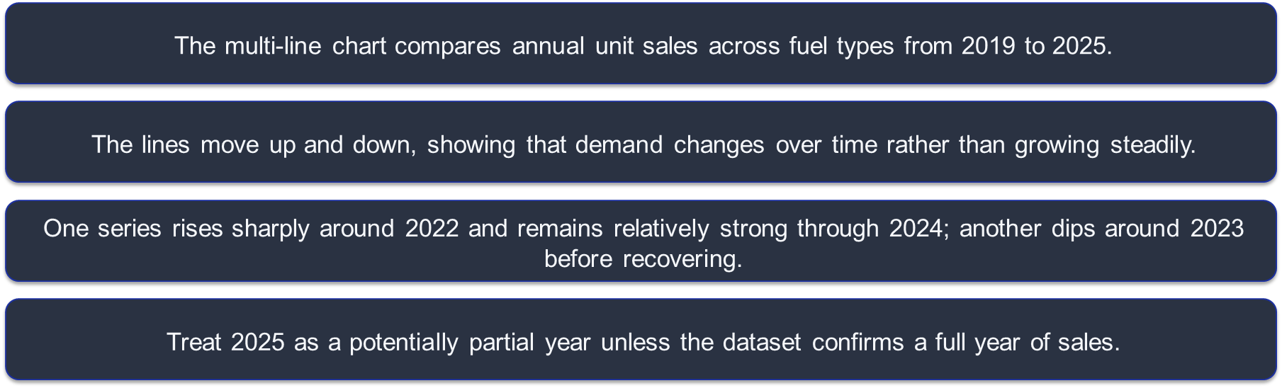
7. Units Sold by Year and Fuel Type
KEY TAKEAWAY
Track each fuel type over time to understand shifts in customer demand

Slide 10
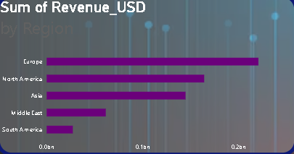
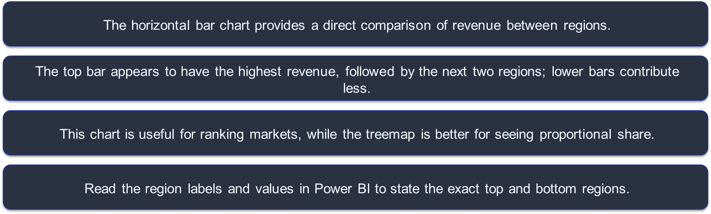
8. Revenue by Region — Ranking
KEY TAKEAWAY
Use the ranking to prioritize market-level sales actions and investigate weaker regions.

Slide 11
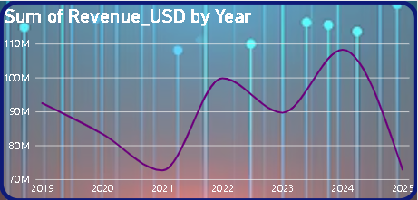
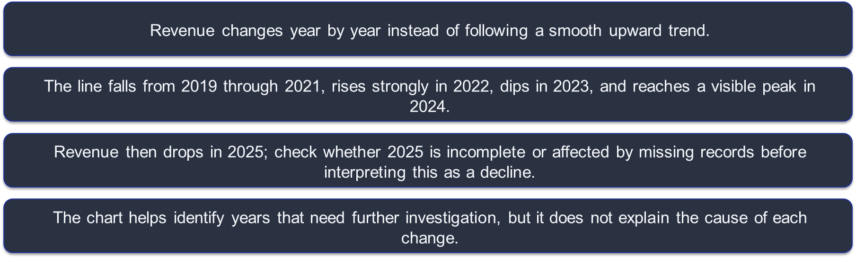
9. Revenue Trend by Year
KEY TAKEAWAY
Validate the final year and investigate the 2024 peak and 2025 decline.

Slide 12
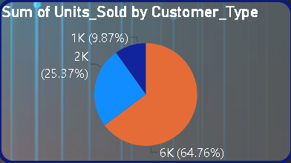
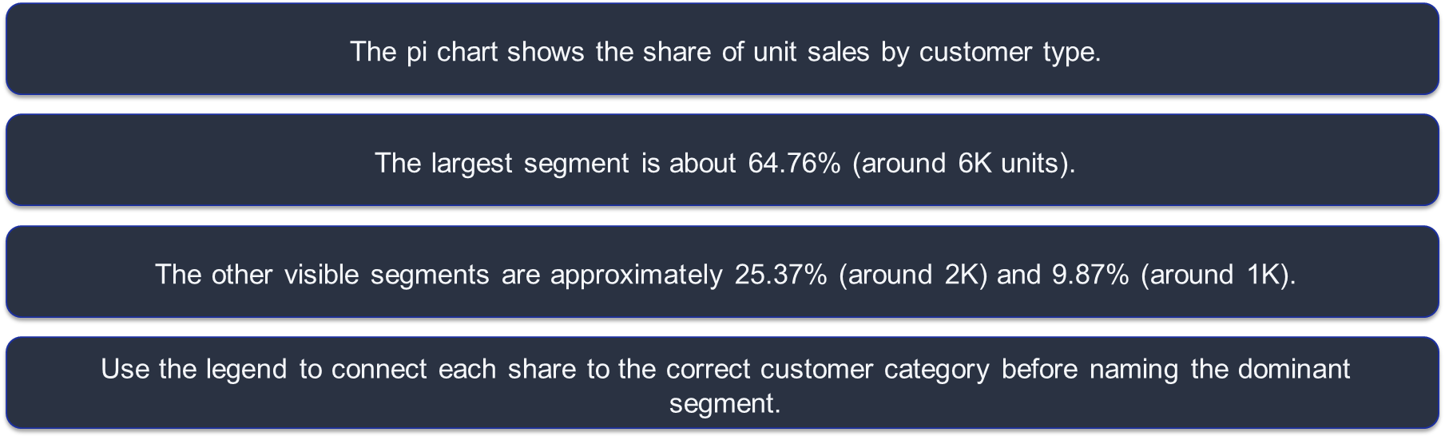
10. Units Sold by Customer Type
KEY TAKEAWAY
Sales depend heavily on one customer segment, so understand and retain that segment while growing others.

Slide 13
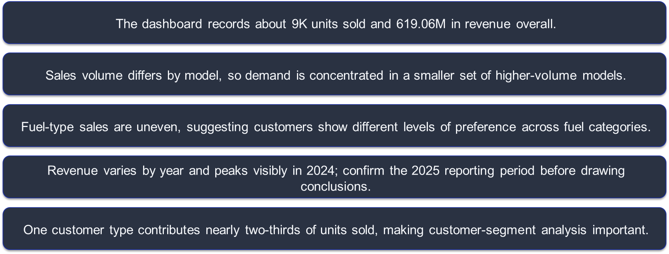
11. Key Business Insights

Slide 14
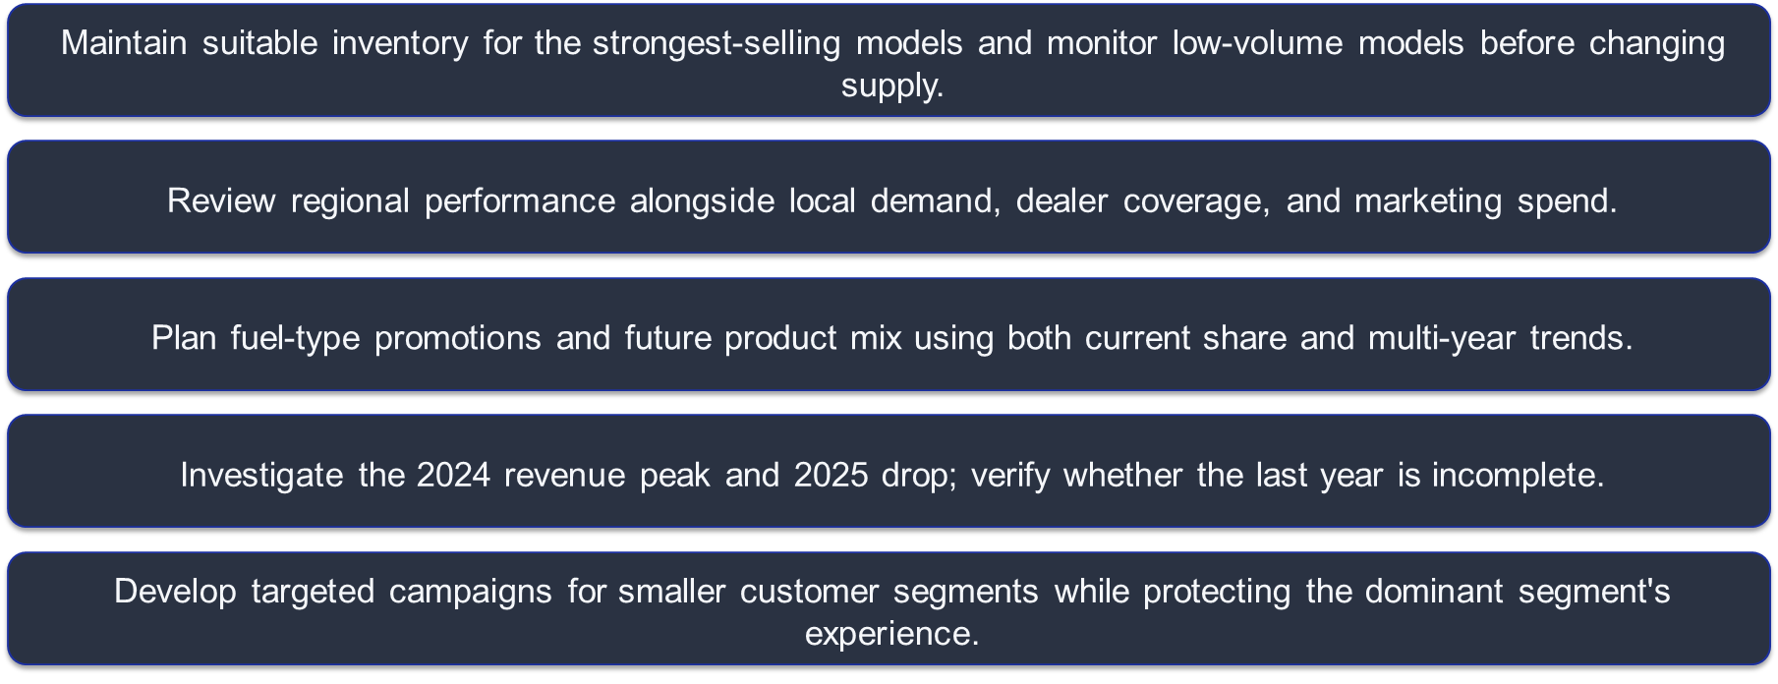
12. Recommendations

Slide 15
13. Conclusion
The BMW Sales Dashboard brings sales volume, revenue, model performance, region, fuel type and customer type into one view.
Its main value is helping decision-makers compare performance, detect changes over time and identify where deeper analysis is needed.

Slide 16
